Slide 1

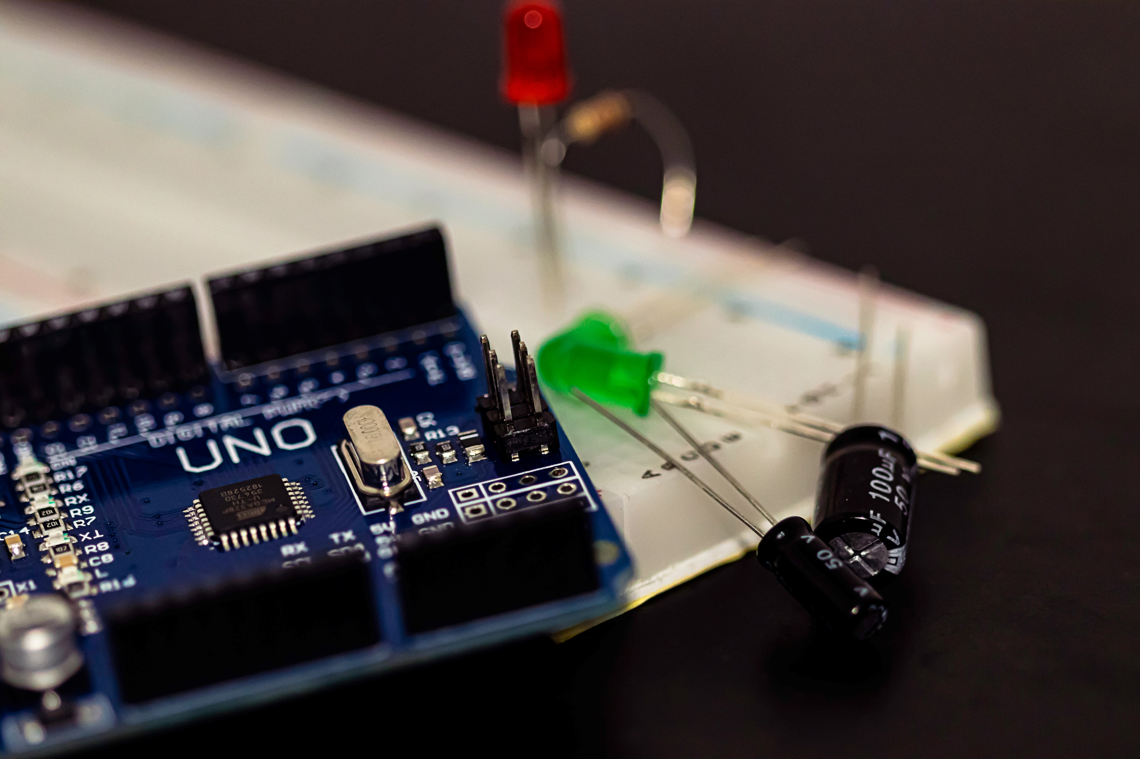

DUAL AXIS SOLAR TRACKER
Objective : The dual axis solar tracker is an Arduino project which shifts the position of a solar panel to the maximum intensity of sunlight thereby utilising optimum solar power . When implemented on a large scale, it is highly energy efficient .

Slide 2

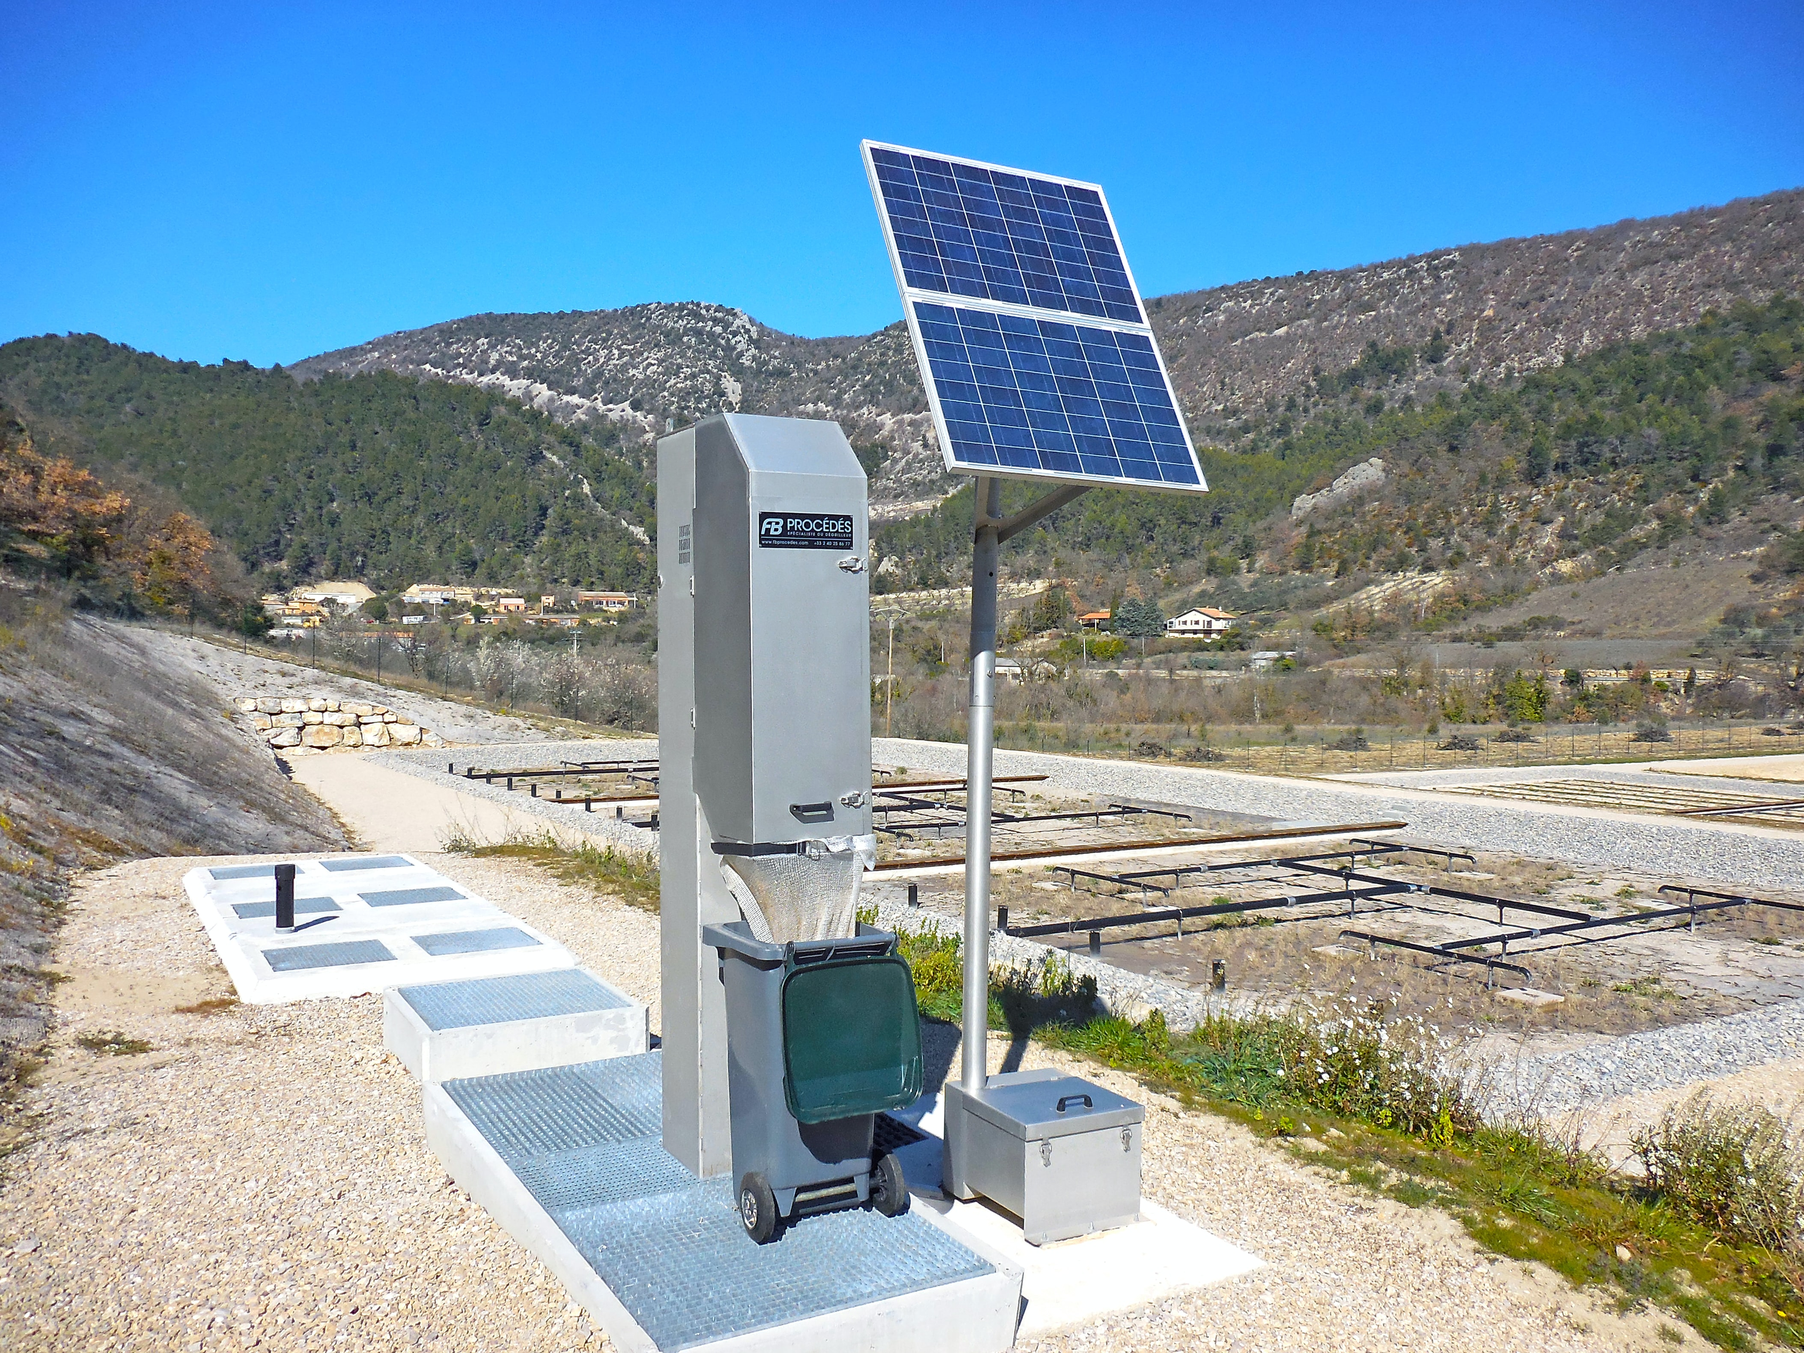
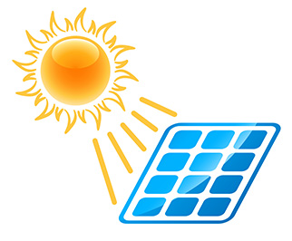
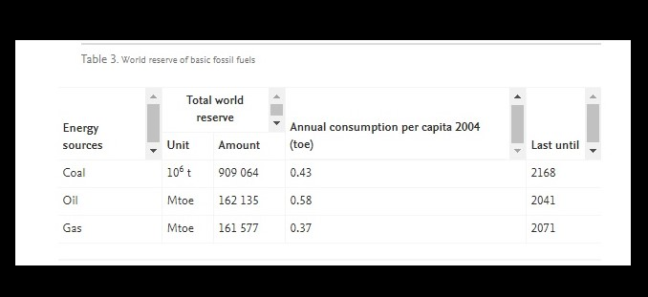
ENERGY CONSERVATION
USING SOLAR POWER
WHY SOLAR ENERGY
Primary Source of inexpensive, accessible, abundant, non-polluting, sustainable, and safe energy resources has been widely utilized to generate electric power in recent years.
EXHAUSTION OF FOSSIL FUELS
SOLAR
ENERGY :
UBIQUITY
SUSTAINABLE
ABUNDANCE
Unavoidable Depletion of Fossil Fuel Resources, Dramatic Increase in Global Energy Consumption, and the critical threat of Climate Change, the need for efficiently utilizing renewable energy resources has become more vital.

Slide 3

“ Biomimicry is innovation inspired by nature”
- Janine Banyus
BIOMIMICRY
MODELLING
The prototype is inspired from a sunflower plant, which is designed on an automatic tracking system, which can locate the position of the sun. The tracking system will align the solar panel so that it is positioned perpendicular to the sun for maximum energy conversion at all times with highest solar intensity.

Slide 4
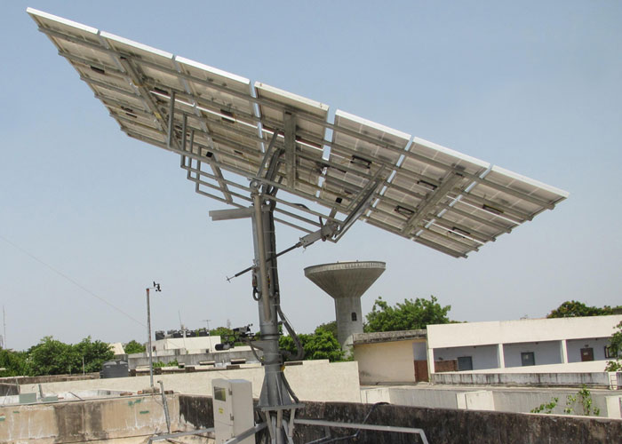
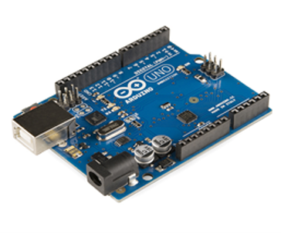
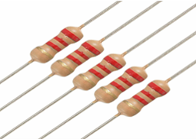
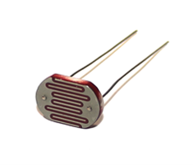
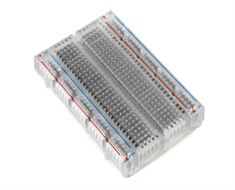
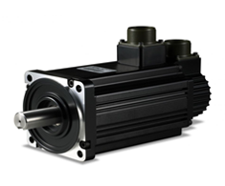
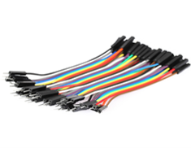
CONSTRUCTIONAL COMPONENTS
Solar power is generated by conversion of radiation into electrical energy using semi-conducting materials known as photovoltaic (PV) cells that convert the sunlight directly into direct current (DC) electricity. To point to the direction with the maximum solar intensity we used a Light Dependent Resistor (LDR).
ARDUINO UNO
RESISTORS
LDR
BREADBOARD
SERVO MOTORS
JUMPER WIRES

Slide 5

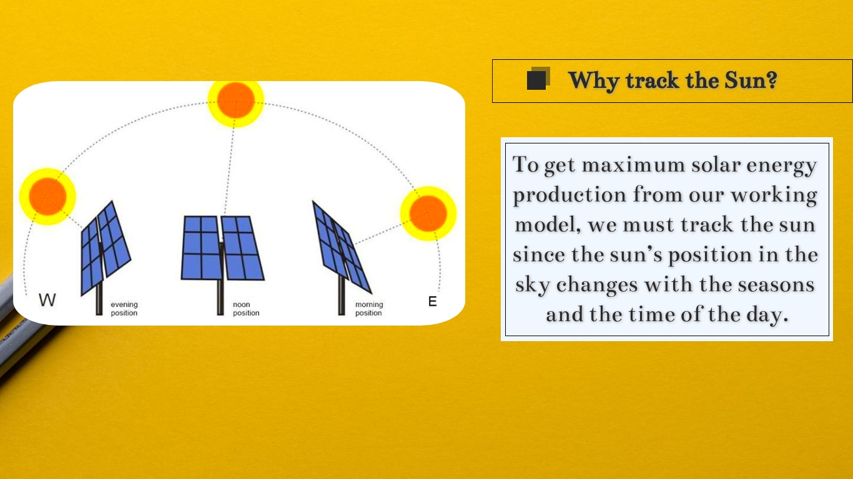
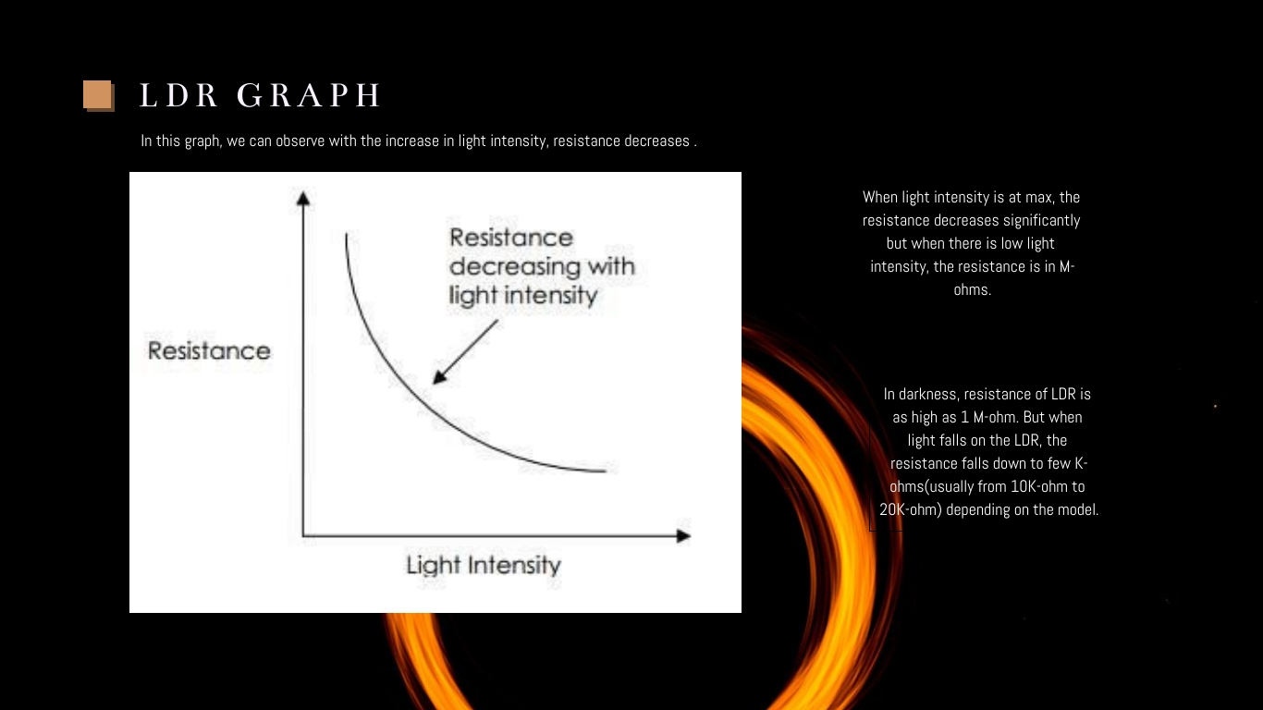
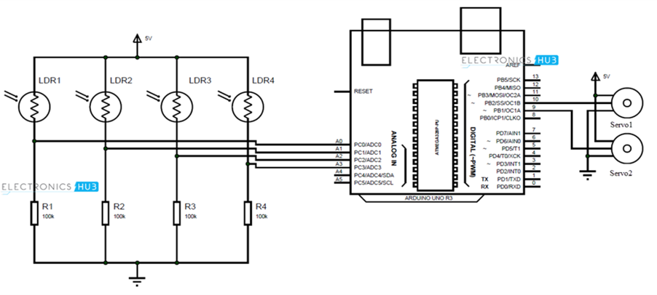
WORKING PRINCIPLE INVOLVED
To get maximum solar energy production from our working model, we must track the sun since the sun’s position in the sky changes with the seasons and the time of the day.
In this graph, we can observe with the increase in light intensity, resistance decreases .
When light intensity is at max, the resistance decreases significantly but when there is low light intensity, the resistance is in M-ohms.
Circuit Diagram of the Microcontroller with the Components

Slide 6
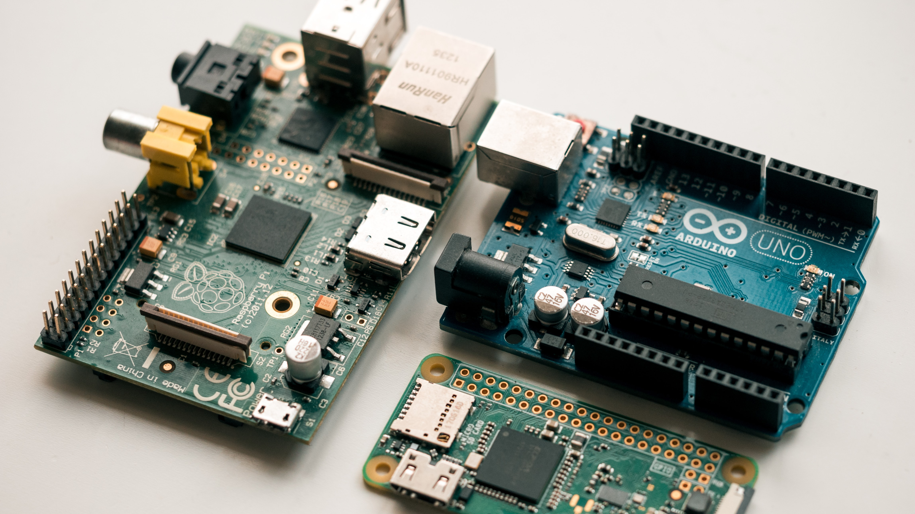
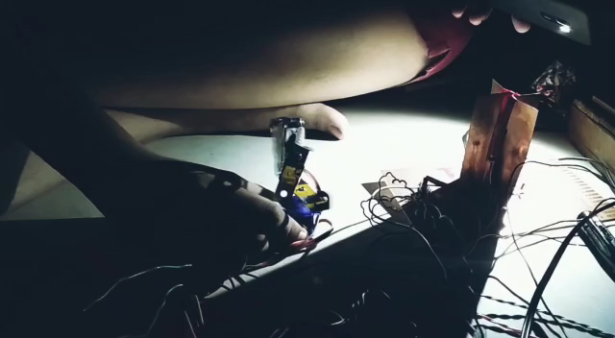
PROJECT VIDEO

Slide 7

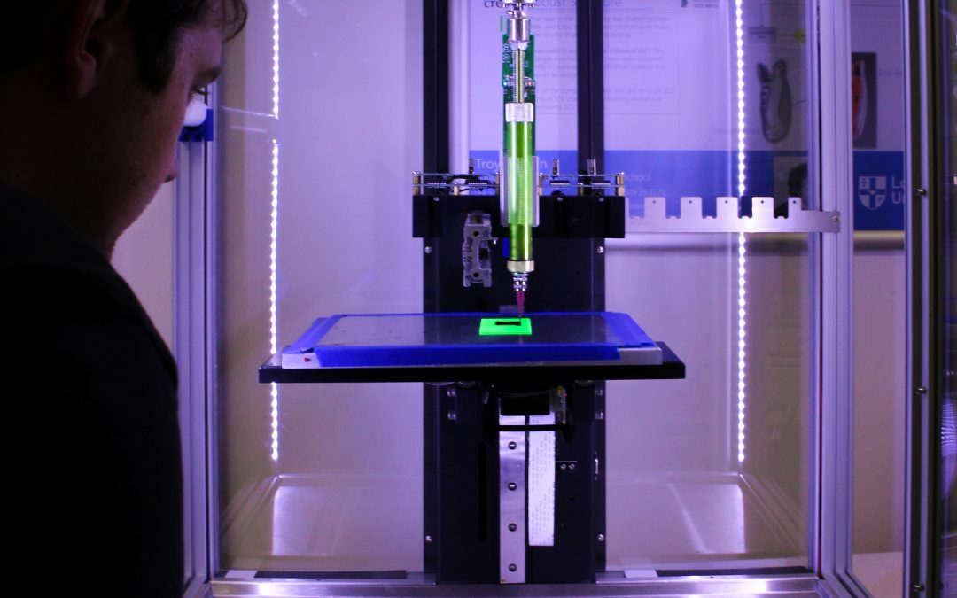

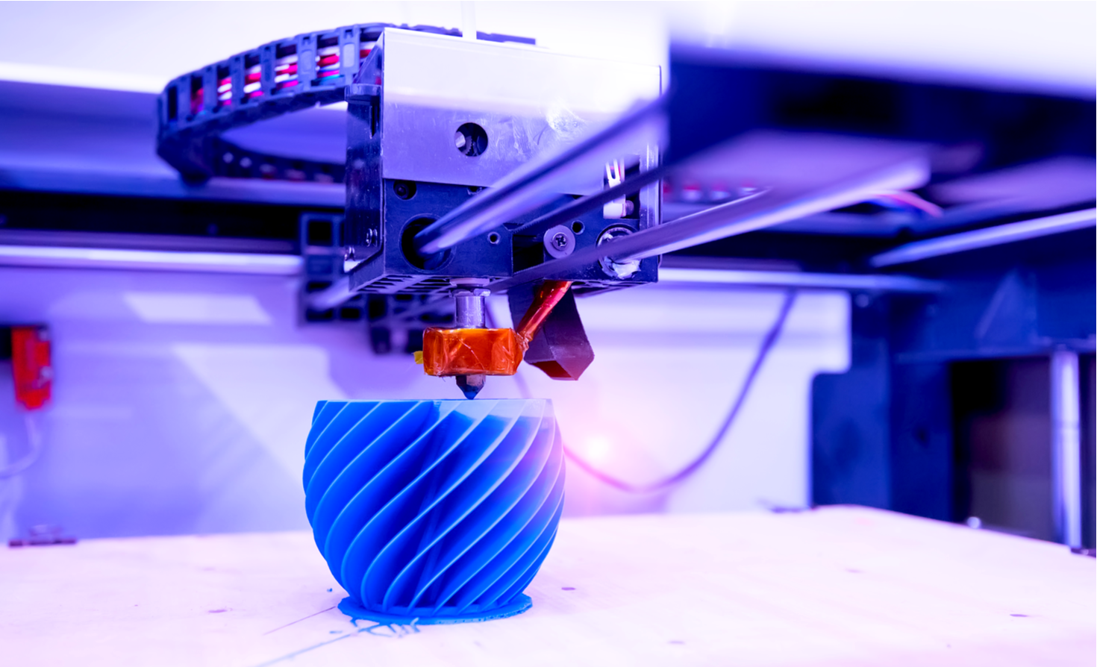
FUTURE PROSPECTIVES
The prototype can be well implemented in a country like India situated in the tropical region and thereby receiving most of the sunlight.
3D printing can lead to 20% more sunlight consumption with almost cost 50% less panels.
It overcomes the problems of pollutions caused by the thermal power plant at the same time scaling for more energy demands
3D printing can lead to reduction in material, production and marketing cost.

Slide 8

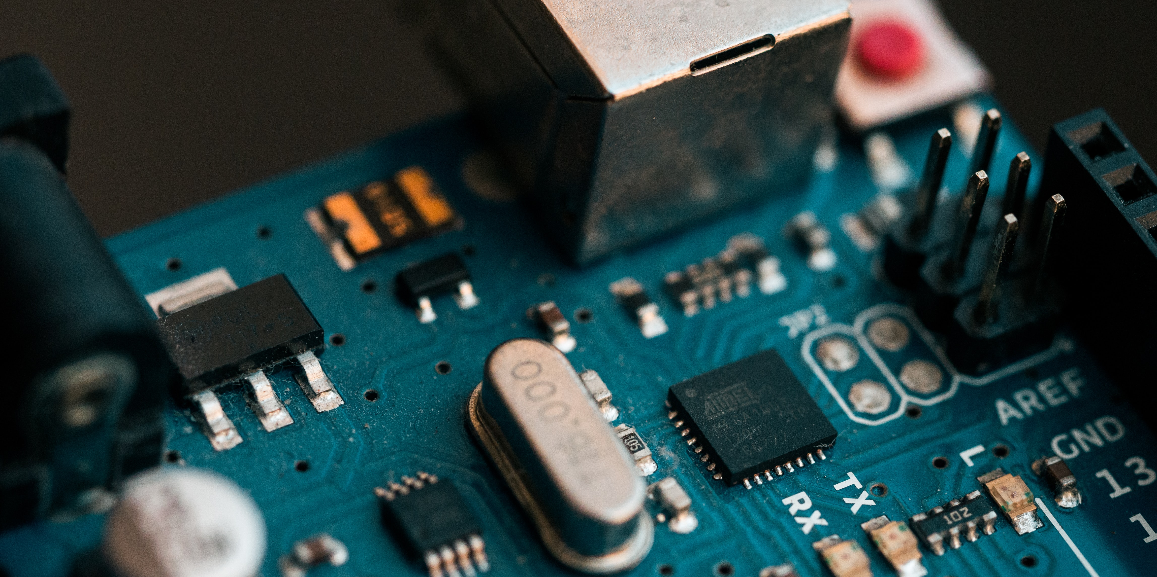



Noyonika Mukherjee
Department of Mechanical Engineering,
3rd Year
THANK YOU !
OUR TEAM
Department of Electrical Engineering,
3rd Year
Farhan Hai Khan
Department of Electronics and Communications Engineering,
3rd Year
Tannistha Pal
Department of Electrical Engineering,
3rd Year
Rounik Roy

